Slide 1
Where should Iowa allocate its marketing budget
Iowa Liquor Analysis:
By : Hermineh Yeghikian

Slide 2
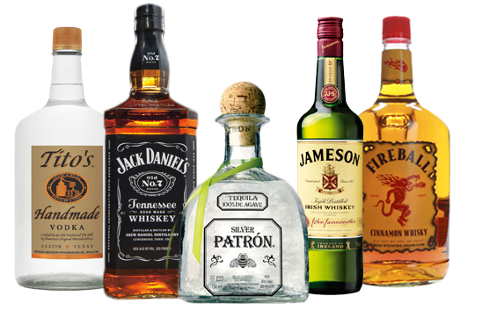
IOWA DATABASE OVERVIEW
4 tables
Data: 2014-2015
Counties:
99 counties
Iowa population: 3,046,352
Sales:
Avg per sale of all stores: $128.62
Avg per sale of bottle price: $18.71
Products:
69 categories
7,276 item description
271 vendors
Stores:
1,973 stores
1,425 active stores
548 inactive stores

Slide 3
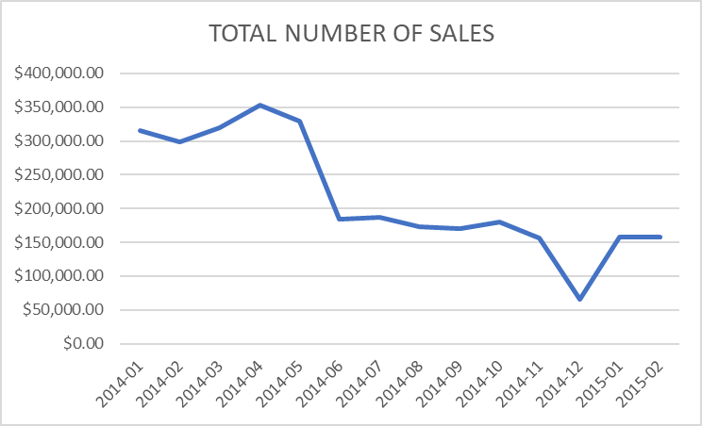
TOTAL NUMBER OF SALES IN 2014 & 2015
TOP 5 PRODUCTS SOLD IN 2014
3,896 raspberry schnapps
4,212 cherry brandies
23,248 coffee liqueurs
78,252 American grape brandies
149,920 flavored vodka
TOP 5 PRODUCTS SOLD IN 2015
872 white crème de menthe
3650 100 proof vodka
5204 watermelon schnapps
6926 American alcohol
10015 apple schnapps

Slide 4
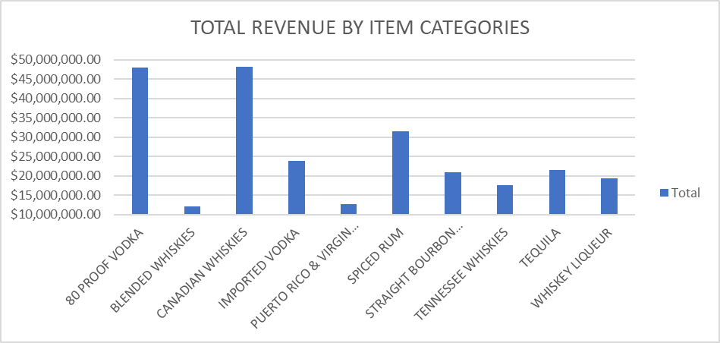
BEST LIQUORS SOLD
Canadian whiskies sell best

Slide 5
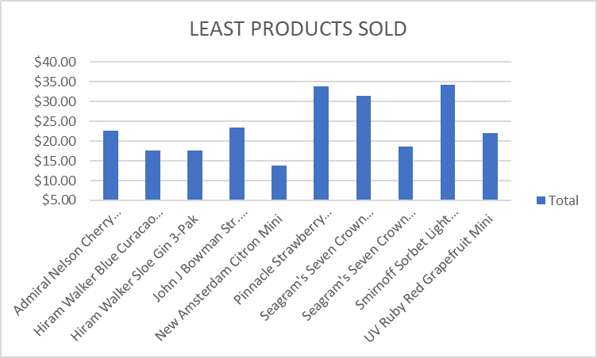
LEAST PRODUCTS SOLD
The lowest product sold is New Amsterdam Citron Mini

Slide 6
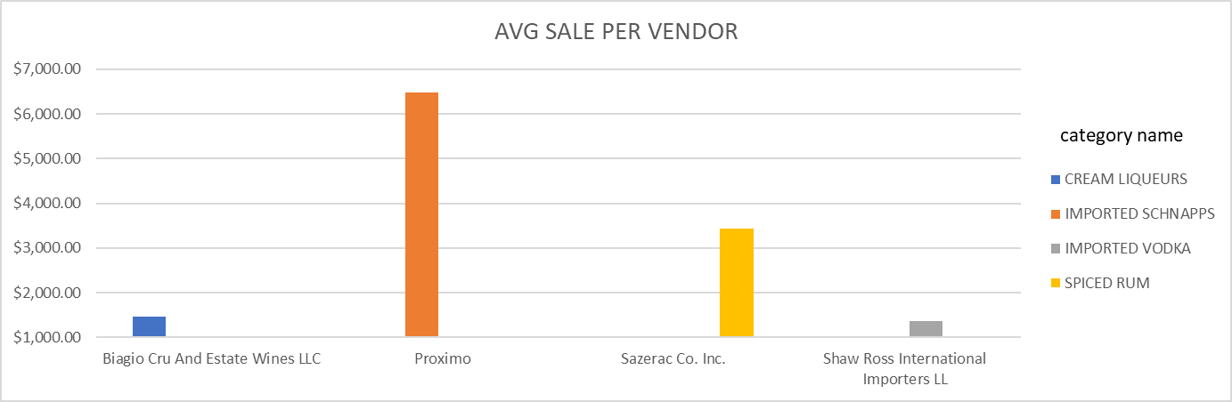
AVERAGE SALE PER VENDOR
Imported schnapps are selling the best by vendor “Proximo”

Slide 7
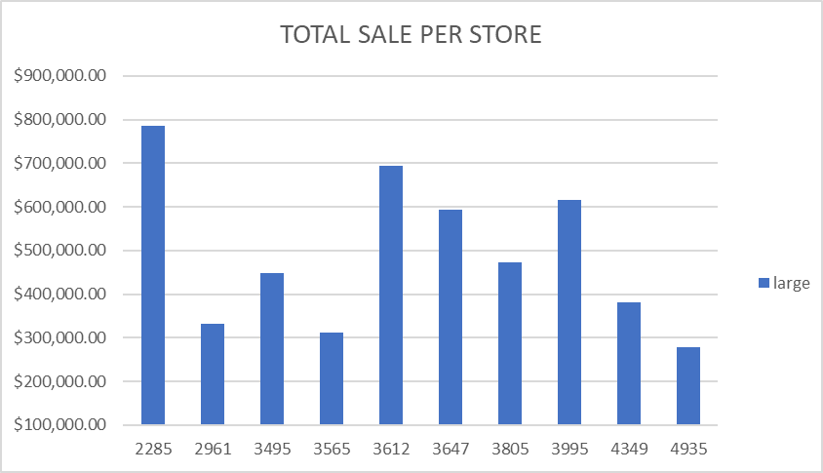
TOTAL SALE PER STORE
Stores are classified as small, medium and large based on total revenue
<$100,000 or less, “small”
>$150,000 or more, “large”
Else “medium”

Slide 8
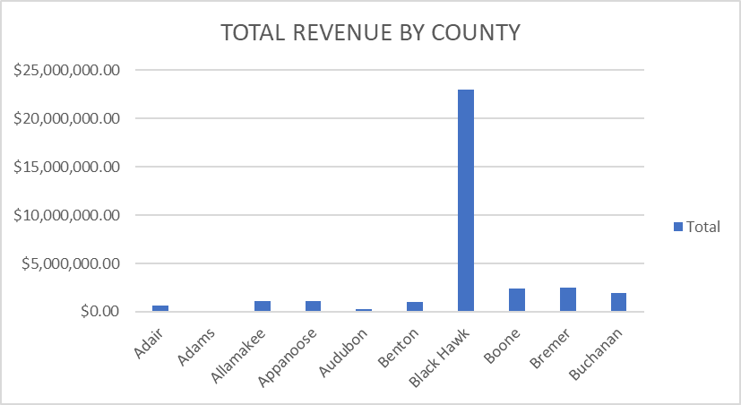
TOTAL REVENUE BY COUNTY
Black Hawk county makes the most revenue

Slide 9
RECOMMENDATION
Look like Canadian whiskies sell the most
Better to allocate budget on the large stores rather than small or medium
Large stores make the most amount of revenue and have already gained market share
Its also best to sell a brand of liquor
Would get rid of small or mid size stores that don’t make a lot of profit
Would also get rid of liquors that don’t sell much

Slide 10
FUTURE RECOMMENDATION
Look into specific types of liquors
Look into specific types of counties
Do a pie chart of vendor, store and county to see what % of sales each gain in the market

